Slide 1
INDUSTRY NEWSLETTER
MAY 2024
Issue Vol: 04
NEWS HEADLINES
Foreign Carriers Engage In Price War To Frustrate Air Peace Out Of London.
Olusegun Ayo Omosehin Appointed As Commissioner For Insurance.
1.5% Of Nigerian Adults Covered By Insurance – National Insurance Commission (NAICOM).
National Insurance Commission (NAICOM) To Tackle Incidences Of Third-party Motor Insurance Irregularities.
Nigerian Insurers Association (NIA) Appoints Mrs. Adebola Odukale As Director General.
Old Mutual Nigeria Sells 100% Of Insurance Business To Emple Group.
Nigerian Council Of Registered Insurance Brokers (NCRIB) Decries Virement In Yearly Budgeted Expenditure For Insurance.
Nigerian Insurers Association (NIA) Unveils Nigerian Insurance Industry Portal (NIIP) To Revolutionize Third Party Motor Insurance.
Dangers Of Acquiring Risk, Failing To Insure It.
Nigerian Healthcare Delegation Returns From WomenLift Health Conference, Equipped To Drive Change In Nigeria.
Unitrust Strengthens Information Security System For Sustainable Growth
National Pension Commission (PENCOM) Rattles Erring Employers, Recovers N25.45bn, Saves Retirees From Old Age Poverty.
National Pension Commission (PENCOM) Drags 61 Employers To Court, Recovers N13.69bn Unpaid Pension Contributions.
Marsh Expands Cyber Facility Echo, Offering Up To $125m Of Excess Insurance Capacity.
May 2024, Gallery.

Slide 2
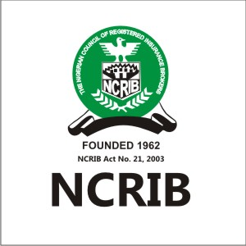
FOREIGN CARRIERS ENGAGE IN PRICE WAR TO FRUSTRATE AIR PEACE OUT OF LONDON.
In the fast-paced and ferociously competitive airline sector, price wars have become like Siamese twins that can not be separated by the actors, as a surviving strategy.
While price wars are a common occurrence in the airline sector, they represent intense competition that sees airlines cut prices in an attempt to snatch passengers from their competitors. The subsequent implication may automatically trigger reduced margins and profitability. To thrive amid these price wars, airlines need strategy and competitive intelligence, specifically competitive flight price data to survive.
This is what is presently playing out in Nigeria’s air transport sector with focus on international flights since Air Peace, a Nigerian carrier, commenced flights to London Gatwick on March 30, 2024.
Prior to the entrance of Air Peace to the Lagos/London route, foreign carriers had, for many years, not only monopolized the lucrative route, but exploited the Nigerian travelers who were made to pay the costliest fares in the region while neighboring countries like Ghana, Togo and Benin Republic enjoyed very low fares.
The exorbitant fares by the foreign carriers reached its peak following the over $800 million of their proceeds trapped in Nigeria with the mega carriers withdrawing their lowest inventory fares, leaving the highest inventory fares for Nigerians to grapple with.
A monthly publication of FSIB
Volume 2024 – May Edition

Slide 3
VISION STATEMENT
To be the leading insurance and reinsurance service provider proffering timely, equitable, quality and excellent risk management solutions to individuals and corporate clients
WHO WE ARE
We are a firm of RISK TRANSFER MANAGERS, the management of which is supported by the experience of professionals, whose vision of total quality management is an everyday culture that aims always at customer satisfaction.
MISSION STATEMENT
We are an organization leveraging on technology to ascertain and support evolving risks of our clients guaranteeing their satisfaction through excellent service delivery.
A monthly publication of FSIB
Volume 2024 – May Edition

Slide 4
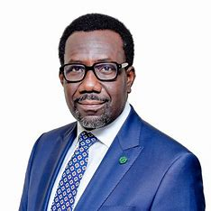
OLUSEGUN AYO OMOSEHIN APPOINTED AS COMMISSIONER FOR INSURANCE.
President Bola Tinubu has appointed Olusegun Ayo Omosehin as Commissioner for Insurance/Chief Executive Officer National Insurance Commission (NAICOM) and also approved the appointment of qualified Nigerians to the Board of the Commission.
Ms. Halima Kyari
Chairperson
Mr. Olusegun Ayo Omosehin Commissioner for Insurance
Mr. Olawoye Gam-Ikon
Deputy Commissioner (Technical Operations)
Dr. Usman Ankara Jimada
Deputy Commissioner (Finance & Administration)
Mr. Adeniyi Olusegun Fabikun
Member
Mr. Umar Khalifa Mohammed
Member
Dr. Miriam Kene Kachikwu
Member
This was contained in a statement issued today by Special Adviser to the President Media & Publicity, Chief Ajuri Ngelale.
He said the President expects the new Board of the National Insurance Commission to exercise utmost probity as it leads the commission in ensuring a safe, sound, and stable insurance sector, while protecting policyholders, the public interest, and improving trust and confidence in the sector.
Mr. Olusegun Ayo Omosehin
A monthly publication of FSIB
Volume 2024 – May Edition

Slide 5
1.5% OF NIGERIAN ADULTS COVERED BY INSURANCE – NATIONAL INSURANCE COMMISSION (NAICOM).
The Insurance Inclusion Studies approximated that only 1.5 per cent – 1.63 million, of all Nigerian adults put at 108.78 million are covered by insurance, the National Insurance Commission (NAICOM), has said.
The Commissioner for Insurance/CEO NAICOM Sunday Thomas, said this in a keynote address at the maiden Independent Newspaper Insurance Summit tagged: Inclusive Insurance: Navigating The New Narratives For Sectoral Growth” held yesterday in Lagos.
The population of Nigeria was 228,047,006 as of Friday, April 19, 2024, based on Worldometer elaboration of the latest United Nations data 1.
The population of Nigerians aged between 18-64 years – adult, was 108.78 million.
Nigeria 2023 population is estimated at 223,804,632 people at mid year.
Nigeria population is equivalent to 2.78 per cent of the total world population.
Thomas, who represented by Deputy Director at NAICOM Ajibola Bankole, noted that the uninsured Nigerians face risks and require better mechanisms to mitigate these risks as an alternative to the informal arrangements currently in use. The low insurance penetration in Nigeria, he said is in part, a consequence of the lack of trust and confidence in insurance companies. A contributor to this perception of the market is the limited knowledge of insurance amongst the public.
According to him, this new narrative demands a multi-pronged approach around Product Innovation, Distribution Channels leverage technology and partnerships and Financial Literacy by investing in financial literacy campaigns that educate Nigerians about the benefits of insurance and empower them to make informed choices.
According to the CFI, the Nigerian Insurance industry has sustained its progressive trend of positive market performance recording a milestone growth to close at N1.003trillion, representing about 27 per cent growth compared to the N790 billion recorded in 2022.
DID YOU KNOW?
You can get Zero Depreciation on our E- Comprehensive motor insurance cover and other benefits.
A monthly publication of FSIB
Volume 2024 – May Edition

Slide 6
NATIONAL INSURANCE COMMISSION (NAICOM) TO TACKLE INCIDENCES OF THIRD-PARTY MOTOR INSURANCE IRREGULARITIES.
The Commissioner for Insurance/Chief Executive Officer of the National Insurance Commission (NAICOM) Olorundare Sunday Thomas, recently paid a courtesy visit on the Director, Road Transport Service, FCTA Dr. Bello Abdul-Lateef. to formally explore areas of collaboration with regards to curbing instances were persons circumvent the system by paying lower premium than expected and issue of “fake” Third Party Motor Insurance.
The Director, DRTS, noted that a lot of individuals renewing their vehicle particulars were not getting value for the insurance premium being paid as they did not validate the insurance policies after purchase even though they might have paid N15,000; whereas the cover they were actually given cost N4,000 considering the fact that they may have engaged unauthorised persons to help process their request.
The Director, DRTS further mentioned they are now leveraging technology to curb such issues and that 98 per cent of its processes are now automated.
In addition, he stated that individuals can commence the process of their vehicle particulars renewal from the comfort of their homes.
The Commissioner for Insurance also informed the Director, DRTS on the enhanced third-party Motor Insurance which became effective 2nd January, 2023 increasing its premium from N5,000 to N15,000 and also its benefits from N1,000,000 to N3,000,000 covers respectively for the protection of road users.
The Commissioner mentioned that effective collaboration between NAICOM and DRTS will help reduce the incidences of Third-party motor insurance irregularity by enhancing active policing to ensure adequate Insurance management system.
DID YOU KNOW?
You can get Zero Depreciation on our E- Comprehensive motor insurance cover and other benefits.
A monthly publication of FSIB
Volume 2024 – May Edition

Slide 7
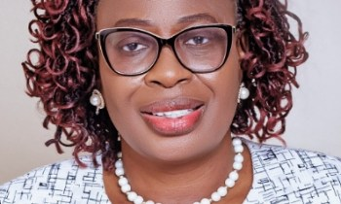
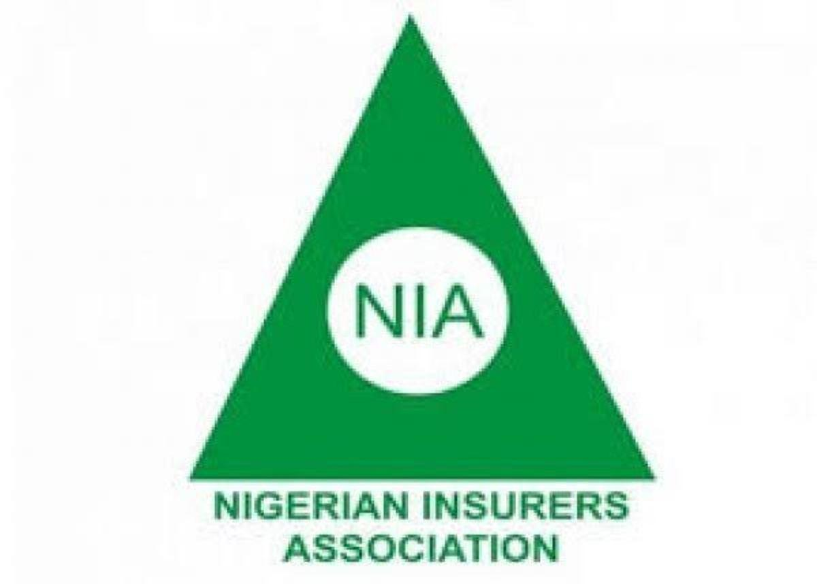
NIGERIAN INSURERS ASSOCIATION (NIA) APPOINTS MRS. ADEBOLA ODUKALE AS DIRECTOR GENERAL.
The Nigerian Insurers Association (NIA) has appointed
Mrs. Adebola Odukale as its Director General.
It was gathered that Mrs. Adebola Odukale, who is taking over from Mrs. Yetunde Ilori, will resume in the month of May 2024.
Mrs. Adebola Odukale, an accomplished insurance practitioner with wide ranging experience in Retail and Group Life Assurance, recently retired as Managing Director Capital Express Assurance Limited.
She began her career with Nigerian Life and Pensions Consultants in 1991 before joining Capital Express Assurance as Manager in 2004, working in various units and departments in Marketing and Technical Operations and rising to become the Managing Director.
She holds a Bachelor of Science degree in Economics from the Obafemi Awolowo University, Ile- Ife; an MBA in Human Resource Management from the Lagos State University; and has attended numerous executive management training programmes locally and internationally.
She is an Associate of the Chartered Insurance Institute of Nigeria, (CIIN).
Mrs. Adebola Odukale
A monthly publication of FSIB
Volume 2024 – May Edition

Slide 8
OLD MUTUAL NIGERIA SELLS 100% OF INSURANCE BUSINESS TO EMPLE GROUP.
Old Mutual Nigeria has announced the sale of 100 per cent of its stake in the General Insurance and Life businesses to the Emple Group.
The Emple Group is an investment company managed by experienced Nigerian investors with a proven track record of delivering best-in-class transaction execution across Sub-Saharan Africa as well as growing its investment in the Nigerian market. This is pending regulatory approval.
This decision follows a thorough strategic review of the businesses which weighed up the immediate-to long-term prospects for both the in-country asset and the broader Old Mutual Group.
Old Mutual West Africa Group CEO, Samuel Ogbu commented: “Since establishing a presence in Nigeria in 2013, it has been our ambition to scale and grow the business in a way that would position Old Mutual as a leading financial services provider in the market.
Along the way, Old Mutual made strategic investments to ensure that the Nigerian businesses remained on the right footing and were able to successfully compete. However, Old Mutual has decided to sell the Nigeria General Insurance and Life businesses, with the key consideration for this transaction being the optimization of capital management.”
Old Mutual confirmed that it would not be leaving Nigeria completely but would maintain a presence in the country through its investment arm, Africa Infrastructure Investment Managers (AIIM). “We see great potential in the infrastructure investments space. AIIM has had great success in the country to date, pursuing opportunities in the sub-region and beyond, through the team in Lagos. Old Mutual currently has significant investment interests in renewable energy, midstream gas, and the digital infrastructure sector in Nigeria through our various AIIM funds. Our view is long-term, and we continue to explore growth opportunities,” added Ogbu.
A monthly publication of FSIB
Volume 2024 – May Edition

Slide 9
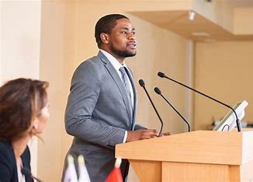
NIGERIAN COUNCIL OF REGISTERED BROKERS (NCRIB) DECRIES VIREMENT IN YEARLY BUDGETED EXPENDITURE FOR INSURANCE.
The Federal Government has expressed its intention to partner with strategic professional institutions towards entrenching viable economic policies that would inflate the economy and guarantee the nation’s sustainable development.
The Hon. Minister of Finance and Coordinating Minister of the economy, Wale Edun, made the assertion when the delegation of Nigerian Council of Registered Insurance Brokers (NCRIB) paid him a courtesy visit in Abuja.
According to Edun, the current administration was giving primacy to getting the economy out of the woods through pragmatic reforms by getting hold of government revenue and monitoring effective outcomes of government policies.
The Minister disclosed that the government realized the need to
collaborate with reputable professional institutions which are believed to bring value to government’s new policy direction, hence an extension of hands of fellowship to notable bodies like the Nigerian Council of Registered Insurance Brokers, especially in its economic task force team.
While advocating the involvement of Registered Insurance Brokers in all government insurance accounts, Oguntade frowned at the practice of virement in yearly budgeted expenditure for insurances by government, noting that the accounting practice had deprived the industry of its required revenue.
The NCRIB President also made a passionate case for the removal of the National Insurance Commission (NAICOM) from the revenue generating agencies of government which led to government deducting 50 per cent front its revenue or income, a situation he said could badly affect the effective legislative oversight of the regulatory body through inadequacy of funds.
A monthly publication of FSIB
Volume 2024 – May Edition

Slide 10
NIGERIAN INSURERS ASSOCIATION (NIA) UNVEILS NIGERIAN INSURANCE INDUSTRY PORTAL (NIIP) TO REVOLUTIONISE THIRD PARTY MOTOR INSURANCE.
The Nigerian Insurers Association (NIA), in a landmark move set to revolutionize the insurance landscape, today officially launched the Unified Nigerian Insurance Industry Portal (NIIP).
This innovative digital platform, NIA said is aimed to ease and streamline the process of purchasing Third-Party Motor Insurance cover while also addressing fake insurance certificates issued by unscrupulous elements in the market.
The association submitted that the Unified NIIP is an enhanced version of the existing NIIP, designed to enable members of the public to purchase Third-Party Motor insurance nationwide.
It offers unparalleled convenience and security to both insurers and the insuring public, with a myriad of benefits poised to reshape the industry.
One of the key advantages of the Unified NIIP is its ability to empower individuals to buy,
renew and report claims on their respective Third-Party Motor Insurance policies from the comfort of their homes, offices, or any other location 24/7 using the internet.
Insurance brokers and agents duly registered and licensed by the National Insurance Commission (NAICOM) can also use this portal to sell insurance to their clients.
Premium payments on the NIIP platform are seamless, offering multiple payment options, including mobile banking apps, fund transfer platforms, ATM cards, and Quickteller. Once payment is made, users can conveniently print or download their certificates directly from the platform, ensuring hassle-free access to essential documentation.
As the Nigerian Insurers Association unveils the Unified NIIP to the public, the Association and its members are of the opinion that the portal will have a highly transformative impact on the insurance market.
With its innovative features, the Unified NIIP is poised to enhance customer experience and usher in a new era of efficiency in the Nigerian insurance landscape, NIA posited.
DID YOU KNOW?
You can get N30,000 medical benefit with N100 local insurance travel cover.
A monthly publication of FSIB
Volume 2024 – May Edition

Slide 11
DANGERS OF ACQUIRING RISK, FAILING TO INSURE IT.
Do you know that there is an elements of risk attached to almost everything on earth. So, when you acquiring a thing, it comes with risk which should be identified and a measure taking to mitigate it.
Having an understanding that risk is attached to all things around us, would help us seek measures to manage the risk.
As risk cannot be determined by us, it means we acquire it whenever we acquire loved items
As risks come with what we treasure, we should make provisions to mitigate them.
An individual who buys a vehicle, gets the vehicle with risks of accident, lost, fire disaster and more. Having bought the vehicle, these associated risks, should be identified and be planned for, to retain the vehicle.
Acquiring a house comes with risk of fire, flood, burglary. These risks have to be effectively managed to keep the house.
Getting a business comes with the risk of fire, burglary, flood, fraud and more.
Securing a job, comes with risks such as accident, sack, professional negligence amongst others.
Getting digital devices such as phone, computer, tablet, camera, comes with risk like damage, lost, theft.
Dangers of failing to insure against risks:
*Total lost
*Inconvenience
*Financial drain
*Erosion of status
*Poverty
Loosing an uninsured business to fire or burglary, can drag an individual into poverty if there is no measure to rebound. Insurance remains one of the best means to rebound, hence, insure what is keeping you out of poverty.
It is good to acquire valuables, but better to manage their associated risks through insurance.
Buy insurance now to secure those loved values, for you wouldn’t get anybody to sell to you when you need it to recovery from a mishap.
A monthly publication of FSIB
Volume 2024 – May Edition

Slide 12
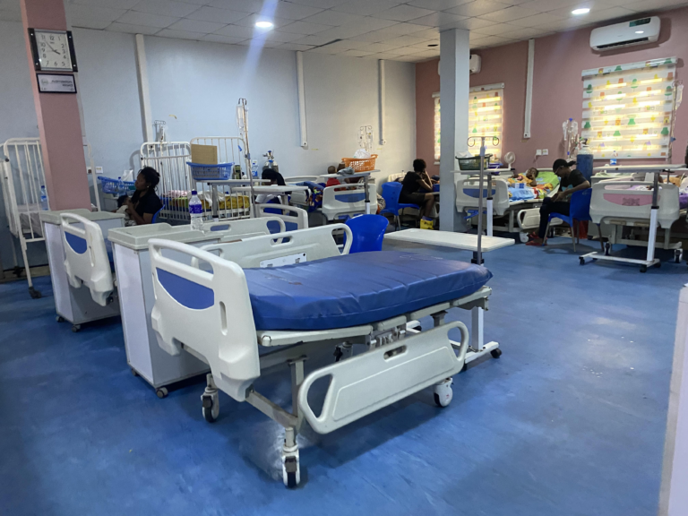
NIGERIAN HEALTHCARE DELEGATION RETURNS FROM WOMENLIFT HEALTH CONFERENCE, EQUIPPED TO DRIVE CHANGE IN NIGERIA.
A high-powered Nigerian delegation, facilitated by the gender-balanced leadership champion WILAN Global, recently returned from the Women Lift Health Global Conference in Tanzania.
This delegation, composed of the Salma Ibrahim Anas, Special Adviser to the President on Health; Hajiyya Umma Ahmed, Health Commissioners for Kaduna State, Ogun State Tomi Coker, Sokoto State, Hajiya Asabe Balarabe, Kwara State, Amina El-Imam, Oyo State Oluwaseresimi Ajetunmobi, Zamfara State Aisha Mohammed Anka alongside WILAN Global representatives participated in workshops and sessions focused on dismantling barriers for women in healthcare leadership.
The delegation’s primary objective was to amplify the voices of senior female healthcare policy leaders on the global stage; by showcasing their invaluable contributions, they aim to inspire future generations of female leaders in healthcare.
Additionally, the delegation provided unique insights into the intricacies of the Nigerian healthcare system, enriching conference discussions and fostering a more holistic understanding of global healthcare challenges.
The conference served as a valuable learning experience for the delegation, strengthening their leadership capacity through networking opportunities and skill-building workshops. This newfound knowledge and connections will be instrumental in their efforts to create a more equitable and inclusive healthcare landscape in Nigeria.
DID YOU KNOW?
You can get N200,000 in benefit for your shop incase of burglary with just N2000 yearly subscription.
A monthly publication of FSIB
Volume 2024 – May Edition

Slide 13
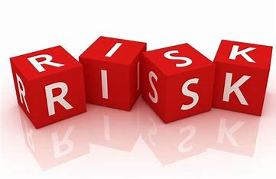
UNITRUST STRENGTHENS INFORMATION SECURITY SYSTEM FOR SUSTAINABLE GROWTH.
Underwriting firm, Unitrust Insurance Company Limited has strengthened its information security system with the receipt of International Standard Organization (ISO) certification that not only equips it for sustainable future growth but also for global standard practice.
The ISO/ IEC 27001:2022 issued by Digital Jewel Africa, the only ISO27001: 9001 consulting firm in Africa looked at the insurers’ operational process, people, compliance, cost and pricing and certified that Unitrust Insurance is benchmarked to global standards.
Achieving ISO/IEC 27001:2022 certification requires a rigorous and thorough assessment of an organisation’s information security management processes, underscoring the insurer’s commitment to protecting its customers’ information and setting a benchmark for excellence in the Nigerian Insurance industry.
“This will ensure that these entities enjoy the benefits of risk management including operational efficiency, reduced financial losses, and reputational damage amongst others.”
He however advised that one of the low-hanging fruits to consider immediately to conserve the nation’s foreign exchange should be aggressive and purposeful advocacy for the replacement of the average Nigerian’s preference and taste for foreign goods and services that can be sourced or produced locally in the country.
This requires a reorientation at all levels whether it be at the family, community, or organizational levels. This change of direction must be evident in the decisions being made and implemented at all levels of the economy whether it is at the constituency, sub-national, national level, or in the private or public sectors.
A monthly publication of FSIB
Volume 2024 – May Edition

Slide 14
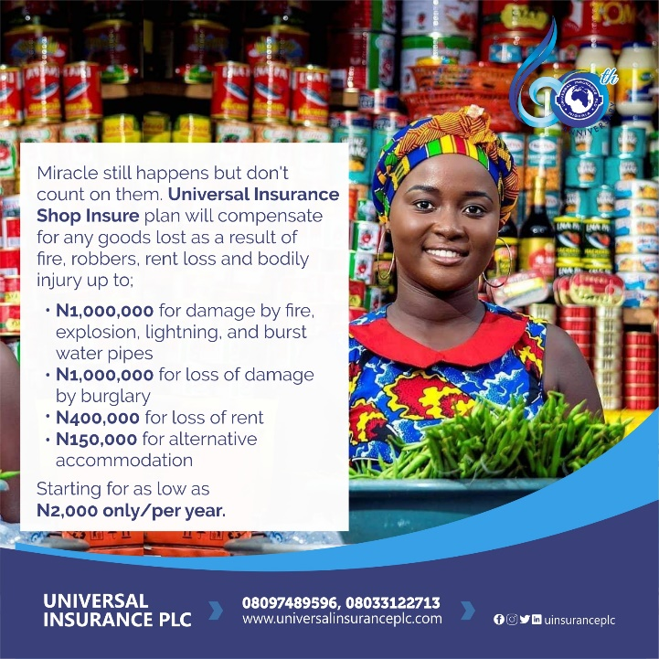
NATIONAL PENSION COMMISSION (PENCOM) RATTLES ERRING EMPLOYERS, RECOVERS N25.45BN, SAVES RETIREES FROM OLD AGE POVERTY.
The National Pension Commission (PenCom) said it has recovered N12.45 billion from employers that failed to contribute towards their employees retirement.
The recovery would indeed help in wealth creation for the workers, thereby securing them against old age poverty in retirement.
PenCom in its 4th quarter 2024 report, said it has maintained the services of Recovery Agents (RAs) for the recovery of unremitted pension contributions and penalties from defaulting employers.
It submitted that during the
quarter, the sum of N319,468,587.45 comprising principal contributions N128,176,029.95 and penalties N191,292,557.50 was recovered from 32 defaulting employers.
It noted that meanwhile, the Commission Secretariat/Legal Advisory Services Department had been requested to take legal action against 4 defaulting employers.
The pension industry regulator maintained that from the commencement of the recovery exercise in June 2012 to 31 December 2023, a total sum of N25,447,085,186.71 comprising of principal contributions N12,929,415,445.52 and
penalties N12,517,669,741.19 was recovered from defaulting employers.
A monthly publication of FSIB
Volume 2024 – May Edition

Slide 15
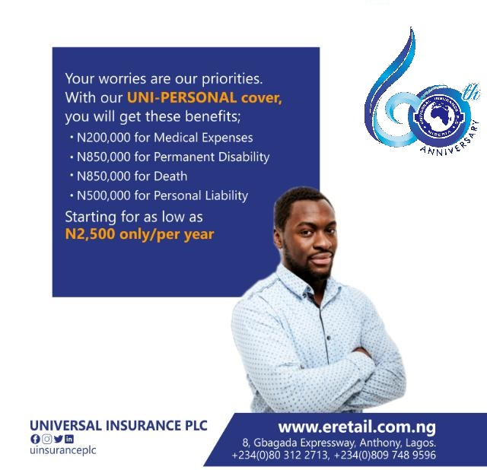
THE NATIONAL PENSION COMMISSION (PENCOM) DRAGS 61 EMPLOYERS TO COURT, RECOVERS N13.69BN UNPAID PENSION CONTRIBUTIONS.
The National Pension Commission (PenCom) has filed cases against 61 employers that failed to remit their outstanding pension contributions and penalties, even as it had recovered N13.69 billion from defaulting employers in five years.
PenCom noted that the cases were filed in 2017, adding that it has continued to record success with respect to matters at the tribunal, as most of the employers have requested to settle out of court, while others have remitted their outstanding pension contributions with penalties to the respective Retirement Saving Accounts (RSAs) of their employees.
The pension regulator posited that in the fourth quarter of 2017, it re-engaged 14 agents to recover outstanding pension contributions and penalties for late remittance, adding that the agents were required to review the pension records of
the employers and recover outstanding pension contributions with penalties, stressing that following the re-engagement, 262 employers were assigned to the agents.
According to PenCom, as at the end of the fourth quarter 2017, the sum of N2.29 billion was recovered by the agents, adding that the recovery brought the total recoveries made by agents since inception of recoveries in 2012 to N13.69 billion, representing principal contribution of N6.95 billion and penalties of N6.75 billion, which had been credited to the respective RSAs of the employees as at fourth quarter of 2017.
A monthly publication of FSIB
Volume 2024 – May Edition

Slide 16
MARSH EXPANDS CYBER FACILITY ECHO, OFFERING UP TO $125M OF EXCESS INSURANCE CAPACITY.
Marsh, the insurance brokerage business of Marsh McLennan, announced an additional $25 million layer of capacity to its existing $100 million Cyber ECHO facility. Available to Marsh clients globally, Cyber ECHO now offers up to $125 million of excess cyber insurance cover and is the largest facility of its kind in the market.
Underwritten by Lloyd’s of London insurers, Marsh’s Cyber ECHO enables clients to access unmatched capacity to address their most complex cyber and technology risk exposures in any territory licensed by Lloyd’s. As a single facility, clients can benefit from an efficient placement process and streamlined claims mechanism. The new $25 million layer follows the same benefits as Cyber ECHO, such as optional reinstatement at pre-agreed rates in the event of a loss that erodes limits.
“As the severity, frequency, and financial impact of cyber threats continues to grow, organizations are seeking the broadest coverage options beyond what is available in the open market,” commented Serena France-Hayhurst, UK cyber placement leader, Marsh.
“The reinstatement of underlying limits and surplus capacity through Cyber ECHO’s new layer offers greater confidence and optionality to clients with increased exposures or more complex operations, as part of their overall cyber resilience efforts,” France-Hayhurst added.
With just N500 you can get insurance cover for your parcel…
A monthly publication of FSIB
Volume 2024 – May Edition

Slide 17
FIRST STANDARD INSURANCE BROKERS
May 2024, Gallery
A monthly publication of FSIB
Volume 2024 – May Edition

Slide 18
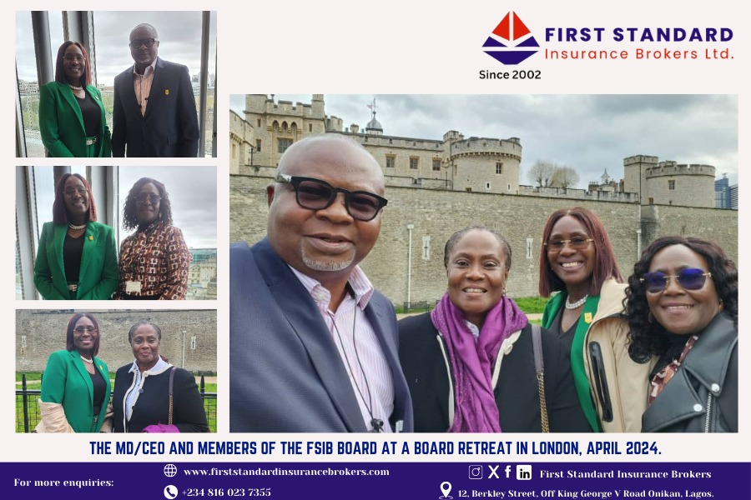
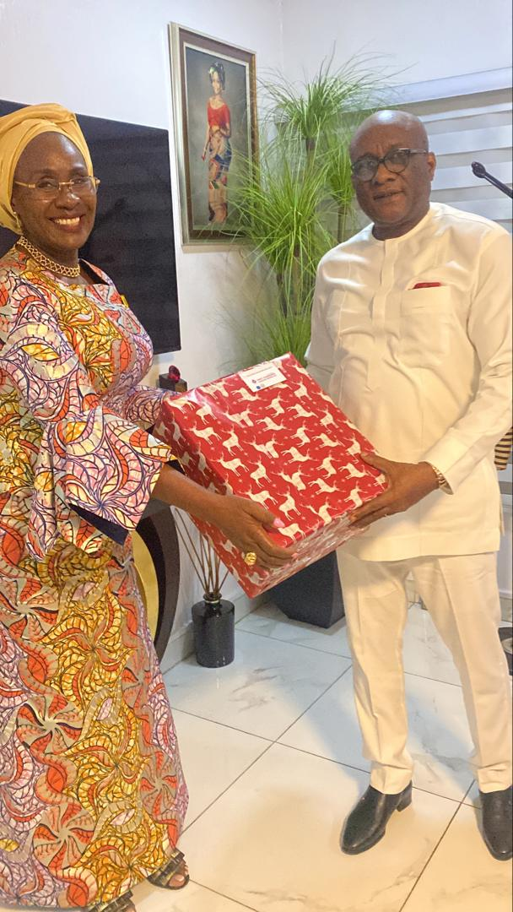
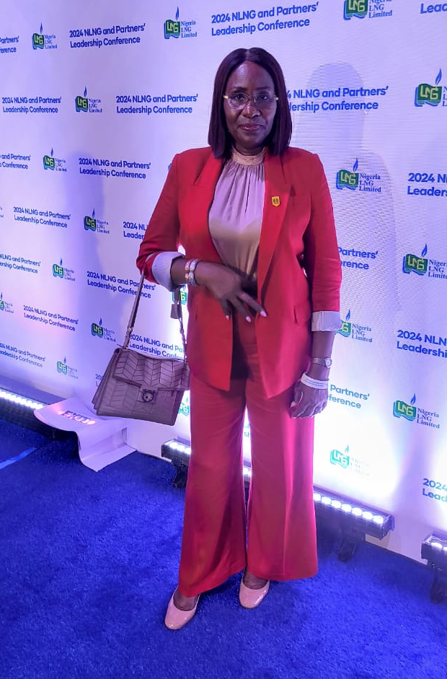
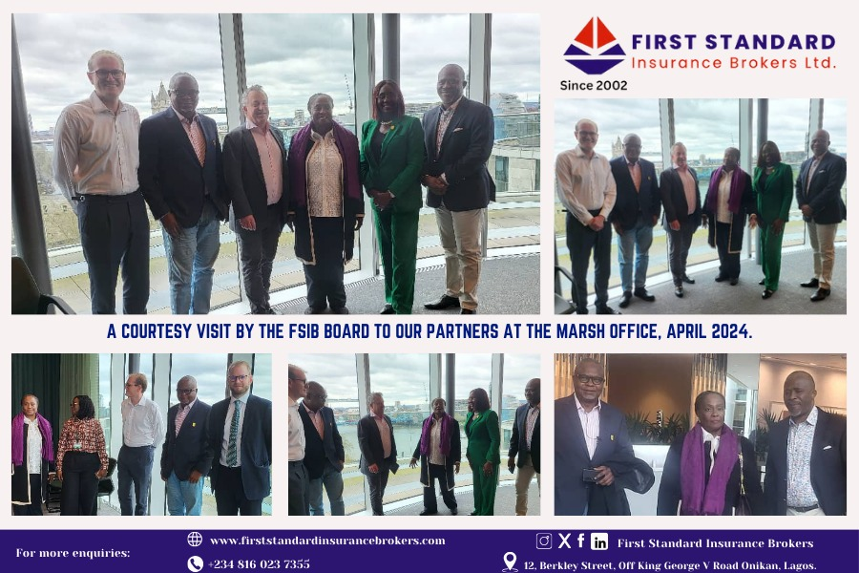
The Managing Director/CEO of FSIB presenting a gift to the Founder/Chairman Air Peace Limited Mr. Allen Onyema on his birthday celebration
The Managing Director/CEO FSIB at the 2024 NLNG and Partner’s Leadership Conference

Slide 19
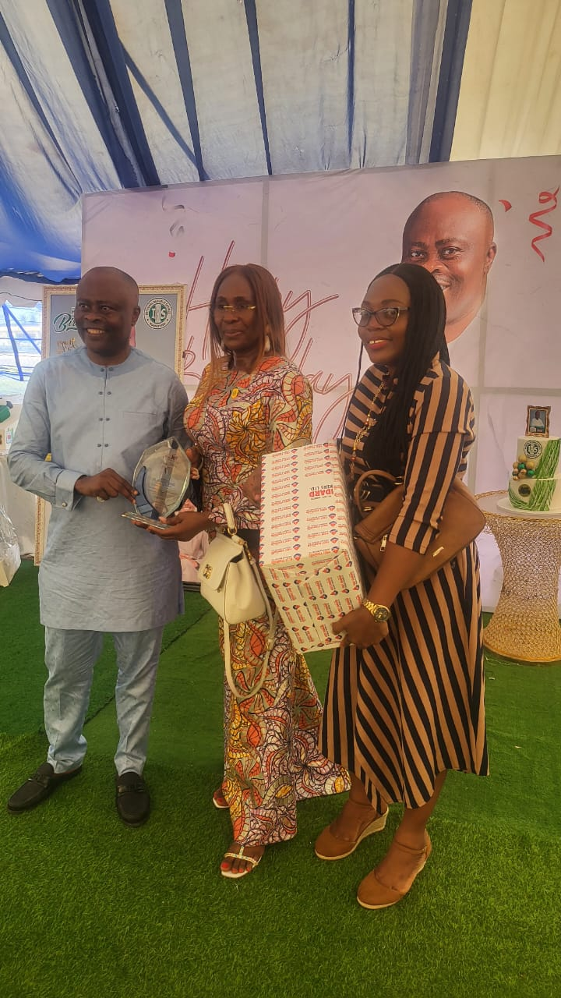
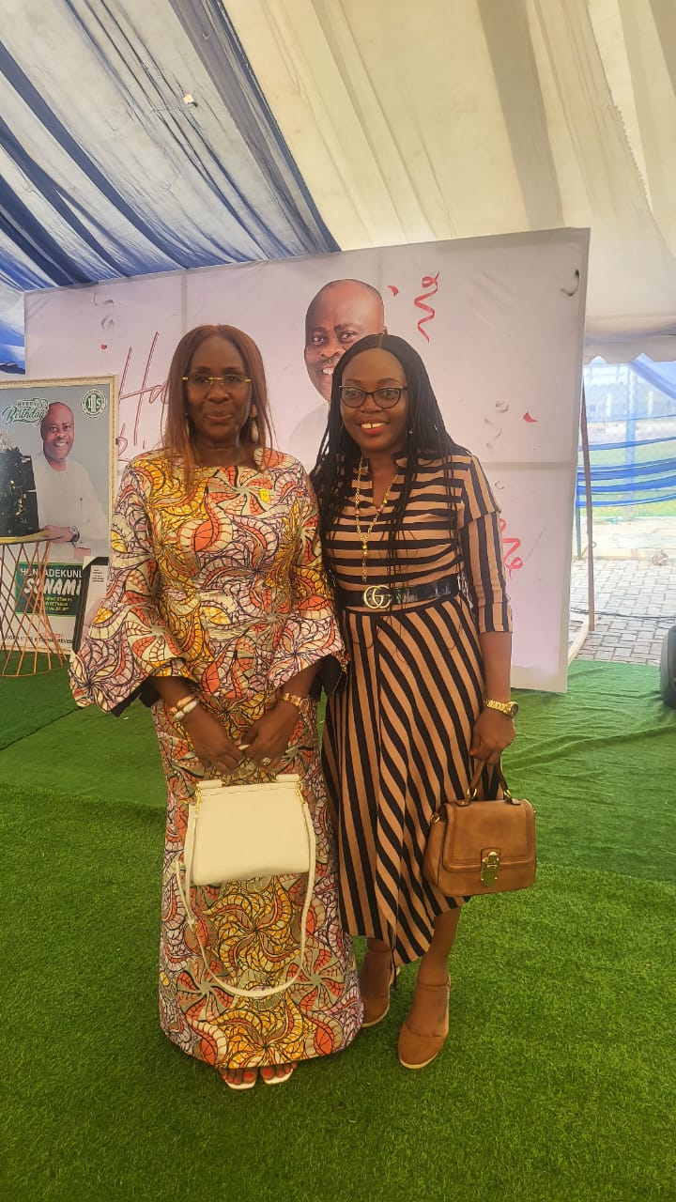
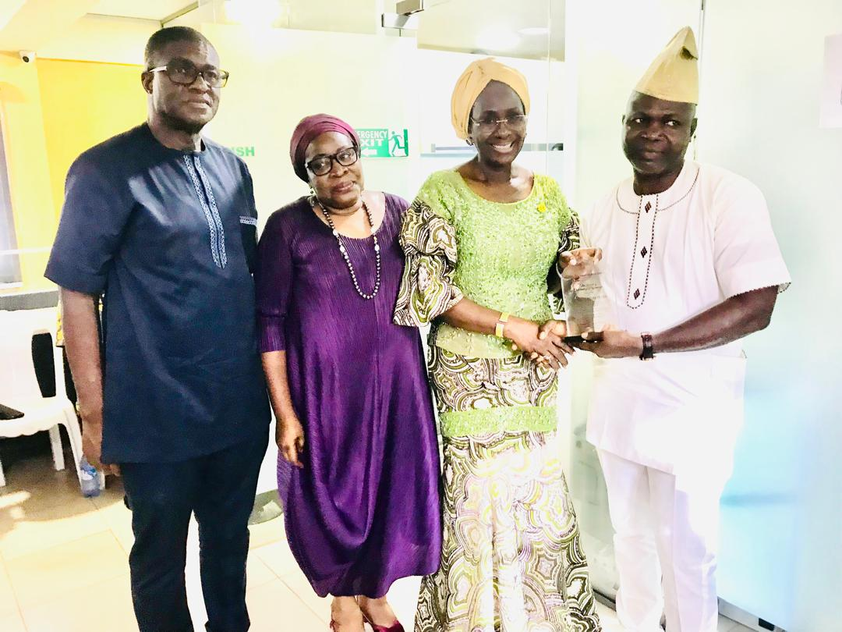
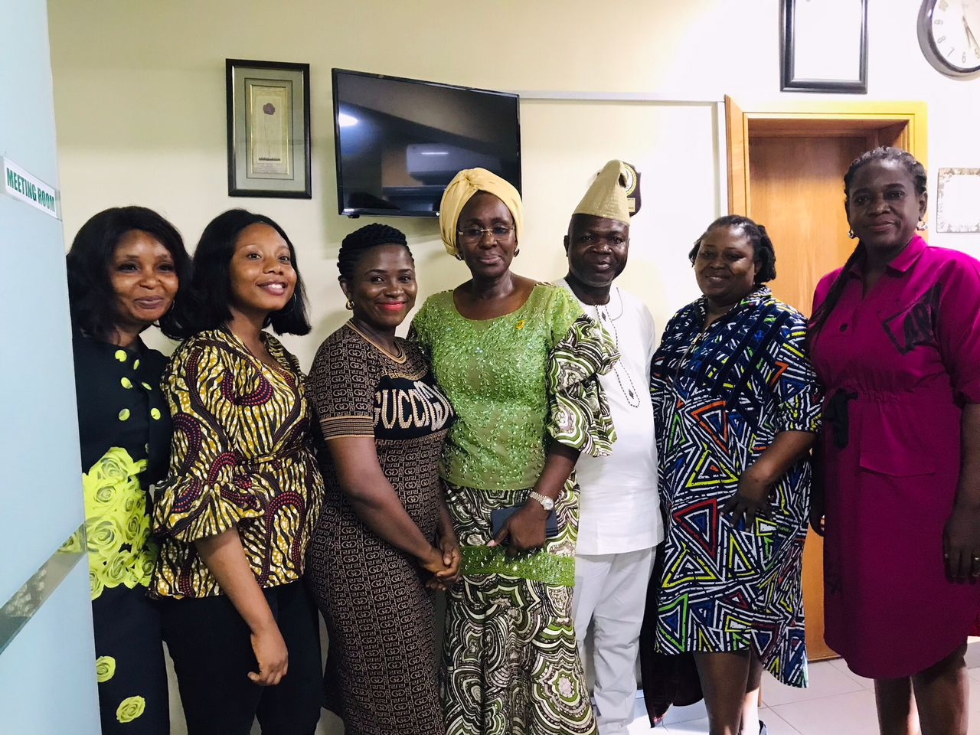
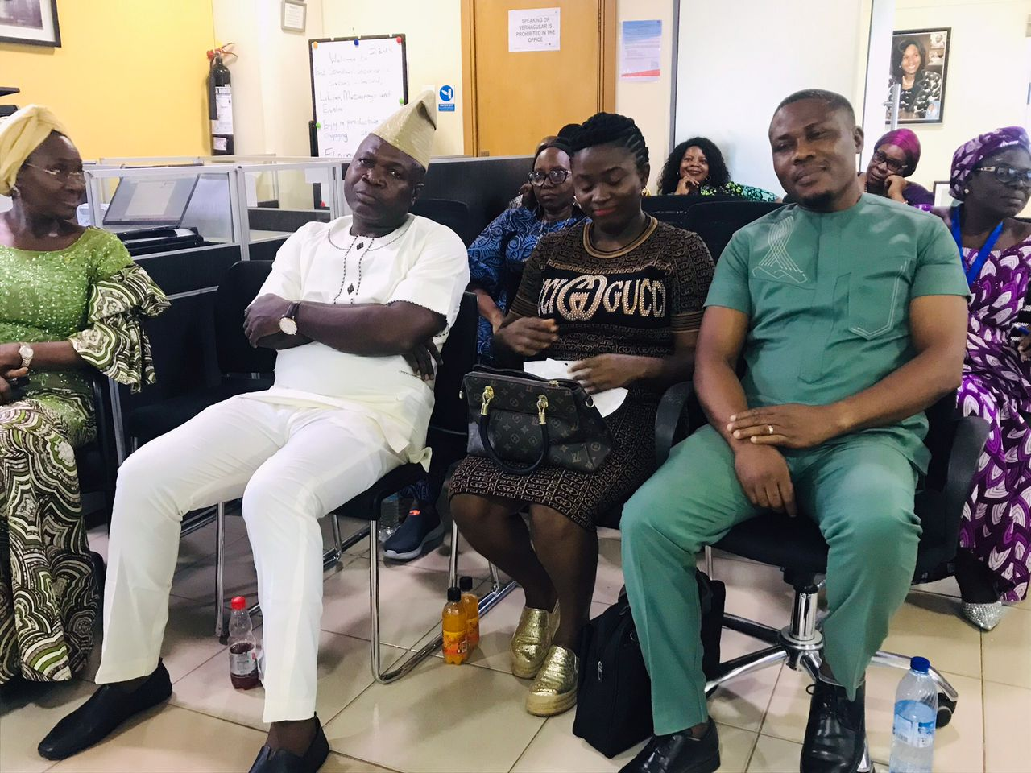
From Left: Company Secretary, Barrister Anthony Ibekwe, FSIB’s HR Consultant Mrs. Amina joining the MD/CEO First Standard Insurance Brokers at the presentation of a Long Service Award to the outgoing Head of Operations Mr. Taofik Rasaq.
The MD/CEO of First Standard Insurance Brokers and Her Staff presenting a gift at the birthday celebration of the Chairman/CEO of ValueJet Mr. Kunle Soname.
The MD/CEO of FSIB with outgoing members of Staff, joined with well wishers and loved ones, during the sendforth party.

Slide 20
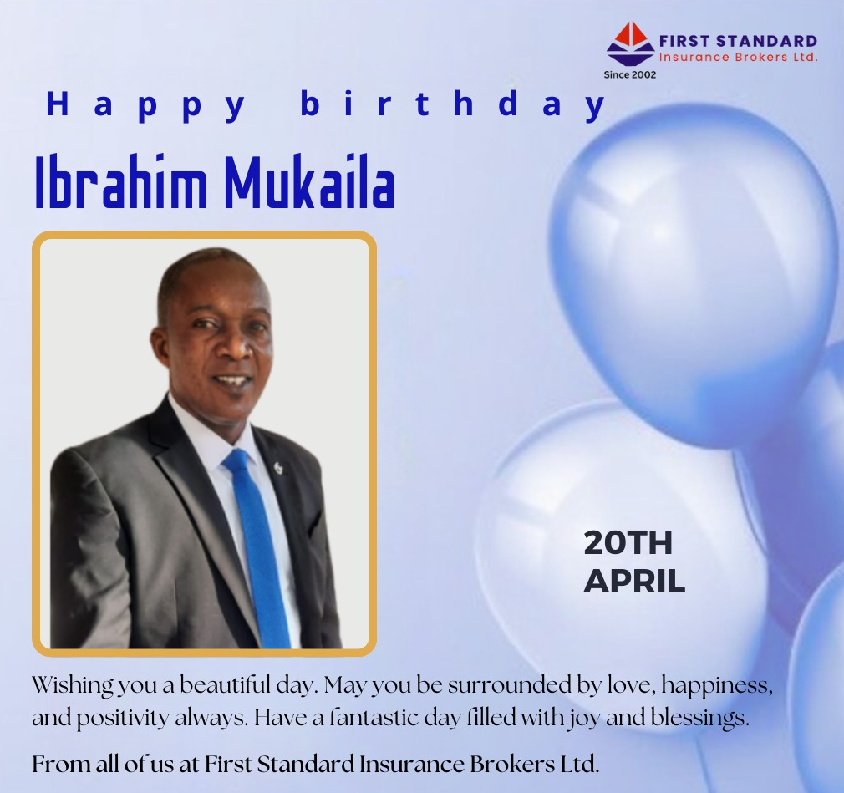
Staff CELEBRATIONS

Slide 21
APPRECIATION
On behalf of the Management and Staff of First Standard Insurance Brokers Limited,
We take a moment to express our heartfelt appreciation for your trust in our business.
Thank you for supporting FSIB.
A monthly publication of FSIB
Volume 2024 – May Edition

