Slide 1
INDUSTRY NEWSLETTER
June 2024
Issue Vol: 05
NEWS HEADLINES
First Standard Insurance Brokers Limited at 22.
Commissioner For Insurance Omosehin, DCT Gam-ikon, DCI Jankara Resume Duty.
National Insurance Commission (NAICOM) moves to embed Insurance in National Credit Scheme.
Chartered Insurance Institute name His Majesty King Charles III as it Patron .
National Insurance Commission (NAICOM) & Nigerian Insurers Association (NIA) Strengthen Collaboration on Prompt Settlement of Genuine Claims.
National Council of Registered Insurance Brokers (NCRIB)-LAC Pledges to Sponsor Insurance Teachers’ Professional Qualifications.
XeJet Airlines Plane Skids Off Lagos Airport Runway.
Emirates Returns to Operate in Nigeria October 1 After 18 Months Pause.
The Federal Airport Authority (FAAN) & National Security Adviser (NSA) Move to Cut Down on Multiple Security Checks at Airports.
Pension Fund Administrators (PFAs) in Stiff Competition as Workers Scramble for Higher Returns, Quality Service.
Namibia Eliminates Mother-child spread of HIV, HBV in Africa’s First.
With Rising Inflation Insurance should be upscaled for realist claims – Fola Daniel.
Nigeria on V0icemail as Investors Answer Angola’s Call with $50b.
WAICA Eyes Harmonization, Uniform Insurance Legislation, Certification for Members.
African Leaders Push for $120bn Aid to Boost Development, Fight Climate Change.
Insurance Bill And Calls For Attention.
Innoson New Plant to Produce 30,000 Cng Buses & Trucks Yearly.
June 2024, Gallery.

Slide 2
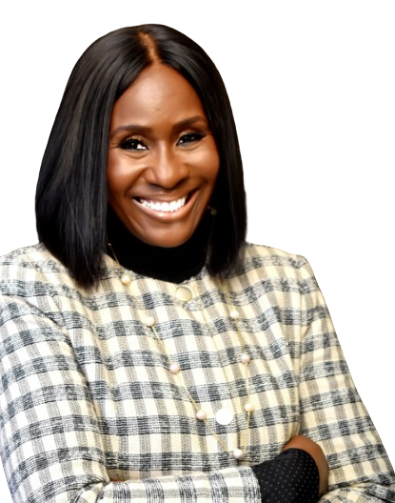
FIRST STANDARD INSURANCE BROKERS LIMITED AT 22.
It gives great joy to announce that First Standard Insurance Brokers Limited is celebrating her 22nd Anniversary.
On this momentous occasion, I extend my heartfelt gratitude to our exceptional clients, dedicated staff, valued partners, and unwavering supporters. Your trust has been the cornerstone of our commitment to delivering top-notch insurance solution and support throughout the past two decades.
We are filled with gratitude for the relationships we have built and the successes we have achieved together. Looking ahead, we are excited to continue delivering professionalism, integrity, and innovation in everything we do.
Here is to greater heights and continual improvement. As we celebrate 22 years of excellence in insurance broking and customer service, we raise our glasses to many more years of success and growth ahead.
We thank all our valued clients and dedicated team for making this journey remarkable!
Dr. Adetayo A. John-Fishers, mni.
The Managing Director/CEO
on behalf of the Board and Management of First Standard Insurance Brokers Limited
13th of May 2024
Source: FSIB’s Corner
A monthly publication of FSIB
Volume 2024 – June Edition

Slide 3
ABOUT US
VISION STATEMENT
To be the leading insurance and reinsurance service provider proffering timely, equitable, quality and excellent risk management solutions to individuals and corporate clients
WHO WE ARE
We are a firm of RISK TRANSFER MANAGERS, the management of which is supported by the experience of professionals, whose vision of total quality management is an everyday culture that aims always at customer satisfaction.
MISSION STATEMENT
We are an organization leveraging on technology to ascertain and support evolving risks of our clients guaranteeing their satisfaction through excellent service delivery.
A monthly publication of FSIB
Volume 2024 – June Edition

Slide 4
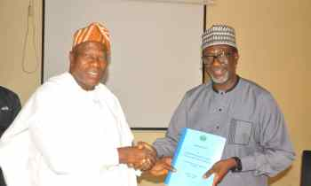
COMMISSIONER FOR INSURANCE OMOSEHIN, DCT GAM-IKON, DCI JANKARA RESUME DUTY.
The recently appointed Commissioner for Insurance Olusegun Omosehin and his team – Deputy Commissioner, Finance & Admin, Ekerete Ola Gam-Ikon and Deputy Commissioner, Technical, Dr. Usman Jankara have resumed duty at the National Insurance Commission (NAICOM).
President Bola Tinubu had on Friday, April 19, 2024, appointed Olusegun Ayo Omosehin as Commissioner for Insurance/Chief Executive Officer National Insurance Commission (NAICOM).
Olusegun Ayo Omosehin - Commissioner for Insurance;
Olawoye Gam-Ikon - Deputy Commissioner (Finance & Administration);
Dr. Usman Jankara Jimada - Deputy Commissioner (Technical Operations);
Dr. Miriam Kene Kachikwu - Member;
Adeniyi Olusegun Fabikun - Member and
Umar Khalifa Mohammed - Member
This was contained in a statement issued by Special Adviser to the President on Media & Publicity, Chief Ajuri Ngelale.
From left: Immediate Past Commissioner for Insurance Sunday Thomas handing over to Commissioner for Insurance Olusegun Omosehin at the National Insurance Commission in Abuja
Source: (www.businessday.ng)
A monthly publication of FSIB
Volume 2024 – June Edition

Slide 5
NAICOM MOVES TO EMBED INSURANCE IN NATIONAL CREDIT SCHEME.
The National Insurance Commission (NAICOM) is taking steps to embed insurance within the national credit scheme, the Commissioner for Insurance Olusegun Omosehin, has said.
He disclosed that his management team welcomed members of the Constitutional Committee on “Mobilization and Diversification” of the Revenue Mobilization Allocation and Fiscal Commission, led by Engr. Sani Mohammed Baba, during their working visit to NAICOM on Tuesday, this week in Abuja.
A statement by NAICOM stated that the primary agenda of the visit was to explore collaborative opportunities to advance the diversification of the Nigerian economy.
Omosehin, in his opening remarks, reaffirmed the critical role of the insurance sector’s regulator in supervising, regulating, and safeguarding the interests of insurance policyholders.
He highlighted insurance’s pivotal role in mobilizing savings for long-term developmental projects and enabling businesses to thrive while managing risks effectively.
He also stressed the Commission’s commitment to ensuring insurance companies meet their obligations, thus contributing to the sustainability of the economy.
Engr. Sani Mohammed Baba emphasized the importance of revenue generation, institutional expansion, and employment creation for Nigerians through collaborative efforts.
The Commissioner for Insurance also acknowledged President Bola Ahmed Tinubu GCFR’s ambitious goal of growing the Nigerian economy $1 trillion by 2026. He expressed the insurance sector’s intent to significantly contribute to this objective.
In closing, Omosehin highlighted the need for continuous advocacy and sensitization of government institutions about the vital role of insurance in national economic development.
Source: (inspenonline.com)
A monthly publication of FSIB
Volume 2024 – June Edition

Slide 6
CHARTERED INSURANCE INSTITUTE NAMES HIS MAJESTY KING CHARLES III AS PATRON.
The Chartered Insurance Institute (CII) says, “it is with great honour that we announce His Majesty King Charles III as our new patron.”
A statement by Dr. Helen Phillips, Chair, CII Group Board, notes that the CII is deeply proud of their longstanding Royal association, which began with King George V granting our first Royal Charter in 1912.
His Majesty succeeds Her Late Majesty Queen Elizabeth II as patron, who granted a new charter in 1987.
They also thanked His Majesty for continuing to support and recognize the work of the CII across the insurance, financial planning and mortgage advice professions.
All eyes are looking forward to the opportunities it presents to extend the benefit the CII brings to individuals and societies around the world, consistent with the Royal Charter.
His Majesty King Charles III
Source: (inspenonline.com)
A monthly publication of FSIB
Volume 2024 – June Edition

Slide 7
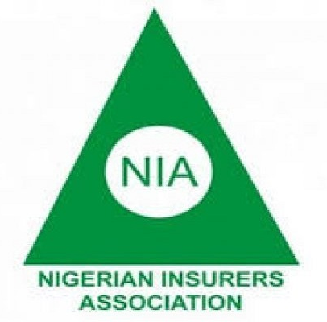
NATIONAL INSURANCE COMMISSION (NAICOM) & NIGERIA INSURERS ASSOCIATION (NIA) TO STRENGTHEN COLLABORATION ON PROMPT SETTLEMENT OF GENUINE CLAIMS
The Commissioner for Insurance (CFI) Olusegun Omosehin, has assured the Nigerian Insurers Association (NIA) of continued collaboration to safeguard consumer rights, particularly in ensuring the prompt settlement of genuine claims.
Omosehin said this when members of the Governing Council of the Nigerian Insurers Association led by the incoming Chairman, Kunle Ahmed, paid a courtesy visit to National Insurance Commission in Abuja.
The CFI affirmed the Executive Management’s ambition to drive growth in the Nigerian Insurance Market.
During the meeting, the NIA’s incoming Chairman extended congratulations to the recently appointed Executive Management of NAICOM and expressed gratitude to the Commission for its pivotal role in maintaining a fair and stable insurance sector.
He emphasized the importance of initiating the implementation of the ten-year strategic plan and finalizing the consolidated insurance bill.
Furthermore, he expressed willingness to collaborate with the new executive, expressing confidence in their ability to elevate the insurance sector to greater heights.
The NIA delegation was briefed on the Commission’s ongoing review of its strategic plan to align it with the Nigerian Insurance Industry’s 10-year strategic plan.
Overall, the meeting showcased a collaborative spirit between NAICOM and NIA, highlighting a shared commitment to advancing the insurance sector and protecting the interests of consumers.
DID YOU KNOW?
You can get Zero Depreciation on our E- Comprehensive motor insurance cover and other benefits.
Source: (inspenonline.com)
A monthly publication of FSIB
Volume 2024 – June Edition

Slide 8
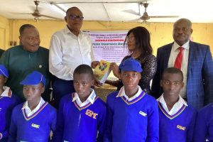
NATIONAL COUNCIL OF REGISTERED INSURANCE BROKERS (NCRIB)-LAC PLEDGES TO SPONSOR INSURANCE TEACHERS’ PROFESSIONAL QUALIFICATIONS.
The Nigerian Council of Registered Insurance Brokers (NCRIB) as part of raising competent hands to teach insurance in secondary schools across the country, has promised to sponsor individuals interested in teaching the subject in acquiring professional qualifications granted by the Chartered Insurance Institute of Nigeria (CIIN).
The Chairman of NCRIB-LAC Demola Olutosin, said this at the NCRIB-LAC Schools Visitation at Oriwu Senior Model College Ikorodu, Lagos, stating that the initiative would help bridge the gap on dearth of insurance teachers in most secondary schools in Nigeria.
Demola Olutosin, who attended Oriwu Senior Model College Ikorodu, Lagos, said NCRIB-LAC is committed to attracting youngsters into the insurance industry by ensuring their teachers acquire the insurance professional qualifications.
He told the teachers and those willing to teach insurance to form an insurance teachers’ club, to ensure easy access to NCRIB-LAC’s programmes and encourage knowledge sharing.
He reiterated the Area Committee’s commitments to enhancing insurance industry manpower through catching youngsters at their early stages in life.
He educated the students, who were drawn from six Senior Secondary Schools in the District, on benefits in insurance sector, whilst urging them to pursue and build a career in insurance, stressing that great job prospects exist for insurance professionals home and abroad.
NCRIB-LAC, at the event donated both exercise and textbooks to the students, whilst promising to sponsor any student who distinguished him/herself in undertaking insurance industry professional examinations.
Representatives of students from the school in attendance applauded the brokers for their kind gesture, whilst promising to make best use of the knowledge acquired at the event.
From left: Chairman Nigerian Council of Registered Insurance Brokers, Demola Olutosin, Past Chairman, Ayo Akande presenting Insurance textbooks to Insurance teacher, Government Senior Model College Ikorodu
Source: (inspenonline.com)
A monthly publication of FSIB
Volume 2024 – June Edition

Slide 9
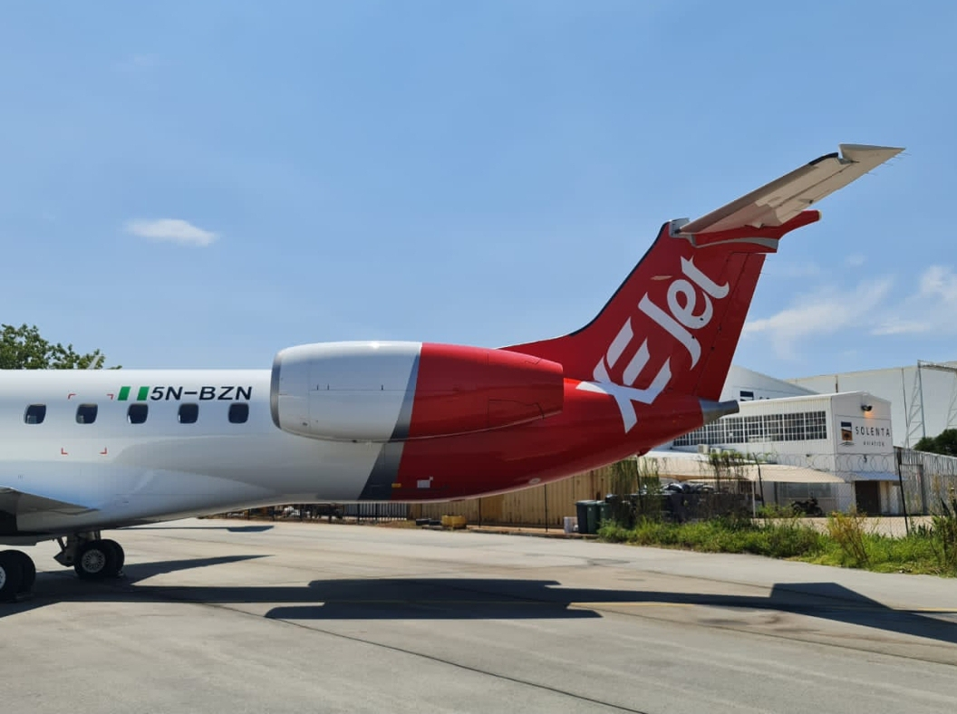
XEJET AIRLINES PLANE SKIDS OFF LAGOS AIRPORT RUNWAY.
An aircraft belonging to a premium services provider Xejet Airlines, skidded off the runway and plunged into the grassy areas of the runway at Lagos Airport on the 11th of May 2024.
The Embraer 145 aircraft, with 52 passengers and crew members on board departed Abuja from Airport before the incident happened.
The Nation reports that, according to sources at the airport, Runway 18L has been closed to aircraft traffic. Personnel from the Aerodrome Fire and Safety Rescue Unit of the Federal Airports Authority of Nigeria (FAAN) have been mobilized to the scene of the incident to rescue the passengers.
Xejet Airlines is a business class-only airline based at Lagos Murtala Muhammed International Airport (LOS).
The aircraft belonging to Xejet Airlines has skidded off the runway at the Lagos Airport. The incident occurred about 11:29 am, as the plane veered into the grass verge by B5. Fire and Rescue personnel were on ground to help in the evacuation of the passengers.
The Nigerian Safety Investigation Bureau (NSIB) confirmed that the Runway18L is closed to traffic.
Source: (www.thecable.ng)
A monthly publication of FSIB
Volume 2024 – June Edition

Slide 10
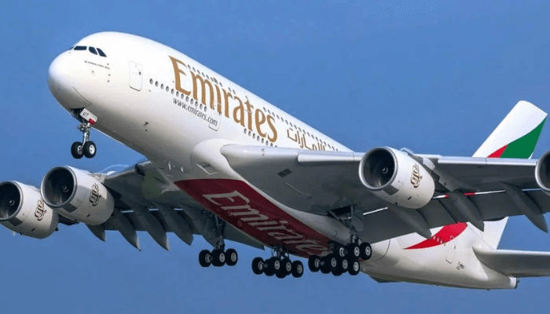
EMIRATES RETURNS TO OPERATE IN NIGERIA OCTOBER 1 AFTER 18 MONTHS PAUSE.
Emirates will resume services to Nigeria from October 1, 2024, operating a daily service between Lagos and Dubai, and offering customers more choices and connectivity from Nigeria’s largest city to, and through, Dubai, the airlines has announced.
The service will be operated using a Boeing 777-300ER. EK783 will depart Dubai at 0945hrs, arriving in Lagos at 1520hrs; the return flight EK784 will leave Lagos at 1730hrs and arrive in Dubai at 0510hrs the next day.
Adnan Kazim, Emirates’ Deputy President and Chief Commercial Officer said, “We are excited to resume our services to Nigeria. The Lagos-Dubai service has traditionally been popular with customers in Nigeria and we hope to reconnect leisure and business travellers to Dubai and onwards to our network of over 140 destinations. We thank the Nigerian government for their partnership and support in re-establishing this route and we look forward to welcoming passengers back onboard.”
As a major economic hub in Africa, Nigeria and the UAE have built strong bilateral trade relations over the years, headlined by Lagos as the nation’s commercial centre. With the resumption of daily passenger flights, the airline’s cargo arm, Emirates SkyCargo, will further bolster the trade relationship by offering more than 300 tonnes of belly-hold cargo capacity, in and out of Lagos every week.
DID YOU KNOW?
You can get N30,000 medical benefit with N100 local insurance travel cover.
Source: (businessday.ng)
A monthly publication of FSIB
Volume 2024 – June Edition

Slide 11
THE FEDERAL AIRPORT AUTHORITY (FAAN) & NATIONAL SECURITY ADVISER (NSA) MOVE TO CUT DOWN ON MULTIPLE SECURITY CHECKS AT AIRPORTS.
The Federal Airports Authority of Nigeria (FAAN) and the office of the National Security Adviser (NSA) have concluded plans to reduce the numbers of military and paramilitary personnels at Nigeria international airports who have physical contact with passengers’ baggage multiple times thus constituting delays and numerous inconveniences to travellers passing through the airports.
Over the years, complaints have increased of the unnecessary multiple checks of passengers’ belongings carried out by the many security agency officers who man checkpoints inside the terminals of international airports.
Experts in the aviation industry have called for a streamlining of such exercises as well as drastic reduction of such agencies personnel while others suggest a centralized structure of checks be adopted to reduce the numbers of human contacts passengers belongings are subjected to.
Olubunmi Kuku, Managing Director of FAAN, at the weekend disclosed that the agency and the office of the NSA have agreed to carry out short and long term measure to address the issue including the creation of a joint coordination room where all the agencies can view CCTV cameras to ascertain what they are looking for.
Kuku described the development as disturbing but affirmed that the issue was the first thing she inquired about upon assumption of office adding that she personally sat down with the National Security Adviser, Mr. Nuhu Ribadu to discuss how to streamline the facilitation processes.
While addressing complaints on multiple baggage checks, the FAAN MD said “On the issues of the checking of baggage, it borders me so much and that was the first inquiry that I made when I assumed office. As far back as 2011 and 2012 when I was in the industry, this was something I have worked on with the former Minister.”
Source: (businessday.ng)
A monthly publication of FSIB
Volume 2024 – June Edition

Slide 12
PENSION FUND ADMINISTRATORS (PFAs) IN STIFF COMPETITION AS WORKERS SCRAMBLE FOR HIGHER RETURNS & QUALITY SERVICE.
Pension Fund Administrators (PFAs) are in stiff competition to retain their current contributors and gain new ones who are taking advantage of the industry’s regulatory transfer window to search for better services.
In this vein, PFAs are now more worried about their returns on investment, as well as services rendered to Retirement Savings Account (RSA) holders, whose appetite for improved service delivery and higher returns are driving interest.
Recent data from the National Pension Commission (PenCom) at the end of 4th quarter 2023 shows that a total of 23, 484 RSAs were transferred between PFAs alongside the associated pension assets valued at N105.76 billion.
This covers RSA transfer requests submitted by PFAs from 1 September to 30 November 2023 that were due for transfer in the fourth quarter of 2023.
Pension Transfer Window introduced in 2020 by PenCom allows contributors otherwise called Retirement Savings Account (RSA) holders the flexibility to move their funds from one PFA to another at least once every two years.
Michael Oyebola in Money Counsellors 2023 Annual Report on Pensions with the theme: ‘Navigate your pension journey with confidence said the transfer window stands as a pivotal opportunity for RSA holders to reassess and optimize their retirement savings managed by their PFAs.
Data from PenCom, according Money Counsellor shows that from 2, 799 RSA holders who transferred to new PFAs in fourth quarter 2020 amounting to N18.90 billion, the figure rose to 12, 872 in fourth quarter 2021 with total amount of N42.49 billion, and 34,283 in fourth quarter 2022 amounting to N131.79 billion same fourth quarter 2022.
For the half-year period in 2023, a total of 34, 359 RSA holders transferred to new PFAs with total N158.60 billion exchanging hands among the PFAs.
Source: (businessday.ng)
A monthly publication of FSIB
Volume 2024 – June Edition

Slide 13
NAMIBIA ELIMINATES MOTHER-CHILD SPREAD OF HIV, HBV IN AFRICA’S FIRST.
Namibia hosts over 200,000 people living with HIV and new infections disproportionately impact females, according to the World Health Organization (WHO).
The East African country achieved the milestone by integrating primary health care with antenatal, child health, and sexual and reproductive health services.
It also committed stable domestic finance to national health programmes, offering widely accessible, quality, free clinical services and support.
Namibia’s first National Elimination Strategy was initiated in 2014, followed by the National Roadmap to Elimination of HIV and syphilis in 2020, with viral hepatitis B added later.
It established a multisectoral National Validation Committee to eliminate the three diseases in line with WHO guidance.
Based on specified criteria, WHO awarded Namibia “silver tier” status for progress on reducing hepatitis B and “bronze tier” for progress on HIV.
Matshidiso Moeti, WHO Regional Director for Africa, said Namibia’s achievement demonstrates the life-saving possibilities of committed political leadership and effective implementation of public health priorities.
With concentrated efforts, she said: “We can accelerate progress to reach the goals of ending mother-to-child transmission of HIV, hepatitis B and syphilis – the triple elimination.”
WHO’s Triple Elimination Initiative aims to safeguard the health of mothers and children and affirm the rights of every child to be born free from the burden of these viruses.
Source: (businessday.ng)
A monthly publication of FSIB
Volume 2024 – June Edition

Slide 14
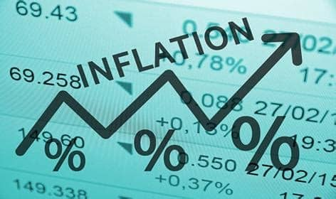
WITH RISING INFLATION INSURANCE SHOULD BE UPSCALED FOR REALIST CLAIMS – FOLA DANIEL.
To ensure that insurance claims are realistic and adequate in an inflationary environment, policyholders should consider upscaling their policy value.
By upscaling insurance coverage and considering these factors, policyholders can better protect themselves from the impacts of inflation and ensure that their insurance claims are realistic and effective in meeting their needs.
Fola Daniel, managing director, FBS Reinsurance (FBS Re) made the remark on the side-line of a three days training program anchored jointly by FBS Re and Munich Reinsurance(Munich Re) of South Africa, aimed at addressing technical knowledge gaps in the insurance industry.
Daniel who is also a former commissioner for Insurance and CEO, National Insurance Commission (NAICOM) said with the devaluation of currency, most sum-insured have become grossly inadequate.
According to him, if you bought a vehicle for N80 million last year and you continue to insure it, may be depreciated by 25 percent, and you insured for N60 million at renewal, it makes book sense, but insurance is about indemnity, placing you in the position you occupied before the loss.
“So, with the current price at N200m, the depreciated value of N65m will not provide adequate indemnity (claim), as a result of the combined force of inflation and currency devaluation.” In the event of a loss, the insured may not be able to replace the car at the current selling price. This is one of the effects of the devaluation, Daniel said.
“We relate that to vehicle, what of building? As at this time last year, a bag of cement was N5,000.00 by April last year, in April this year, cement was sold for N12,000.
So, if you value your property, looking at the factors of construction – cement, labour and others, at N10 million.” A N10 million indemnity today will not build a house. So, there is a need to upscale the values in line with inflationary trends to be able to receive a realistic indemnity, he said.
Source: (businessday.ng)
A monthly publication of FSIB
Volume 2024 – June Edition

Slide 15
NIGERIA ON VOICEMAIL AS INVESTORS ANSWER ANGOLA’S CALL WITH $50B.
Nigeria’s grip on Africa’s oil production throne is waning as neighboring Angola surges in popularity with international oil companies.
Investment in Angola’s oil sector increased by 96 percent between 2022 and 2023, with investments of almost $50 billion recorded over the last five years, according to data sourced from Angola’s National Oil, Gas and Biofuels Agency (ANPG).
Over the next five years, investments of around $71 billion are planned, which does not include investment in incremental production, said Jerónimo, Chairman of the Board of Directors at ANPG, said in the state company’s investor note.
Since 2017, Angola has been undertaking aggressive industry reforms to ensure a transparent and competitive oil and gas market.
The country introduced a six-year licensing round in 2019 which guarantees yearly investment opportunities in exploration for foreign players.
The most recent of these – a 12-block tender covering blocks in the Lower Congo and Kwanza Basins – featured 53 bids, underscoring the scale of interest in Angola’s oil and gas.
José Barroso, Angola’s secretary of state for oil and gas, explained that the country’s national regulator and concessionaire, ANPG, will continue to aggressively promote the industry, pushing bid rounds in line with national production targets.
Barroso stated that Angola offers regulatory flexibility with regard to oil and gas agreements.
“In addition to production-sharing agreements under the six-year licensing round, the country introduced a risk-reducing alternative in 2020, enabling the awarding of risk service contracts when the public bid process is unlikely to succeed,” Barroso said in an interview monitored by BusinessDay.
According to Barroso, the government is open to discussing terms and finding a balanced agreement that provides the right returns for investors.
He added that the government is open to license renewal, thereby ensuring a strong and long-term relationship between oil companies and the state.
Source: (businessday.ng)
A monthly publication of FSIB
Volume 2024 – June Edition

Slide 16
WAICA EYES HARMONISATION, UNIFORM INSURANCE LEGISLATION & CERTIFICATION FOR MEMBERS.
The West African Insurance Companies Association (WAICA) has stressed the need for harmonization of insurance regulation and education to strengthen regional cooperation and build a vibrant, progressive and virile insurance market in the West African subregion.
Delivering the theme paper on “Building a Common Insurance Market in West Africa: Challenges and Prospects” at the just concluded Annual General Meeting and Education Conference in Banjul, Gambia, Dr. Samson Omale, posited that “as important as the place of insurance is in the economic development of any nation, its full potential cannot be exploited without markets coming together to gain from the exponential synergistic effect of such association.
It is for this reason that countries all over the world are forming common markets, citing examples from countries in the EU, and CIMA zone which have for a very long time
realized this necessity and have formed common regulations and directives that bind the operations of insurance activities in their various zones.
He averred that as the economies of the world’s many nations become increasingly entwined, a coordinated approach to legal problems like harmonization has a strong appeal and increasing harmonization of cross-border finance and trade regulations in Africa’s sub-regions is likely to further raise revenue potential of insurance in the coming years.
He stated that in the EU, harmonization means exercise of the freedom to provide services by insurance companies in the zone based on the agreed professional and organizational requirements of the insurance companies, adding that the same can be replicated in the West African sub region
On the way forward for member countries, he urged WAICA to pursue harmonization by achieving consensus among stakeholders, including governments, regulatory bodies, educational institutions, and industry associations, and Taking steps to address divergent interests, priorities and
regulatory environments which tend to complicate negotiations and decision-making processes, slowing down progress towards harmonized insurance educational standards and practices, among others.
Source: (inspenonline.com)
A monthly publication of FSIB
Volume 2024 – June Edition

Slide 17
AFRICAN LEADERS PUSH FOR $120BN AID TO BOOST DEVELOPMENT & FIGHT CLIMATE CHANGE.
African heads of state are pushing for an ambitious $120 billion in aid as the continent grapples with multiple challenges among which are low development and effects of climate changes.
The 19 leaders called for this support in Nairobi, Kenya, during a summit of African heads of state to discuss an International Development Association (IDA) replenishment on Monday.
Chaired by Mohamed Ould Ghazouani, the head of the African Union, the leaders argued that high levels of debt and high borrowing costs leave them unable to cope with extreme weather events caused by global warming.
Therefore, African countries are pushing for more concessional funding and pauses in repayment schedules when natural disasters strike.
William Ruto, Kenya’s president, said his country and the wider East Africa region faced “severe flooding that has devastated communities, destroyed infrastructure and disrupted our economies”.
Floods last month killed more than 100 people and displaced in excess of 150,000 followed years of droughts in northern Kenya and the Horn of Africa.
As floods hit Kenya and Tanzania, countries in southern Africa, including Zambia and Zimbabwe, are battling droughts that are wrecking agricultural production.
Ruto called on wealthier nations “to meet us at this historic moment of solidarity” by increasing their IDA contribution from the $93bn in 2021 to $120bn in 2024.
The G20 independent expert group has recommended tripling IDA’s financing capacity to $279bn by the end of the decade.
Meanwhile, Ajay Banga, president of the World Bank has warned top economies of the world to support Africa given its burgeoning population and the climatic conditions rocking the boat of the region.
Source: (businessday.ng)
A monthly publication of FSIB
Volume 2024 – June Edition

Slide 18
INSURANCE BILL AND CALLS FOR ATTENTION.
As insurance regulator and operators renew their interest in seeing the long-awaited Consolidated Insurance Bill passed into law, stakeholders have advised insurers not to leave anything undone, regarding the push for timely presentation of the bill to the president. Ebere Nwoji presents their view
Recent statement by the Nigerian Insurers Association (NIA) that it would collaborate with the National Insurance Commission (NAICOM) to finalize issues surrounding the signing into law of the consolidated insurance bill is a cheering news and a development which reinvigorates hope of operators on better days ahead for the insurance sector in Nigeria.
A cheering news because the insurance bill has been long overdue for assent by the federal government having been on the law makers’ table since 2010.
Based on all parameters of measurement, the existing Insurance Act of 2003 in Nigeria is now deemed obsolete to effectively regulate the 21st-century insurance sector. Therefore, there is a pressing need to introduce a new insurance act.
Failure by the former President Muhammadu Buhari to assent to the insurance bill before his exit from office was one of the worst regrets of insurance sector operators and stake holders .
This is despite efforts made by the insurers to get the bill signed before the exit of the former President.
But during a recent visit by NIA delegation led by its in -coming Chairman, Mr. Kunle Ahmed to the new Insurance Commissioner, Mr. Ayo Omosehin, and his management team, the duo agreed to collaborate to see that the present regime of Bola Ahmed Tinubu would not overlook the bill as did the former regime.
During the meeting, the NIA in-coming Chairman emphasized the importance of initiating the implementation of the 10-year strategic plan and finalizing the consolidated insurance bill.
Source: (www.thisdaylive.com)
A monthly publication of FSIB
Volume 2024 – June Edition

Slide 19
INNOSON NEW PLANT TO PRODUCE 30,000 CNG BUSES & TRUCKS YEARLY.
Innoson Vehicles Manufacturing Company Ltd (IVM), Nnewi, an auto manufacturer in Nigeria, has delivered a new multi-billion naira plant dedicated to making Compressed Natural Gas (CNG) buses and heavy-duty trucks.
The new plant, which is about 90 percent completed, can build 30,000 CNG buses annually and is expected to be commissioned soon, according to Innocent Chukwuma, Chairman of Innoson Group.
Chukwuma also disclosed that the company will in conjunction with the University of Nigeria, Nsukka (UNN), build a plant that will be producing tractors and other farm implements.
This comes in response to an appeal by a group of farmers led by Ebere Orji Odi, to IVM to consider producing tractors and related implements to enhance mechanized farming and boost the economy.
Odi said the intervention of Innoson and other auto companies in the manufacturing of farm equipment will boost mechanized farming.
Alfred Nwosu, a media consultant and director of Innoson Group, said the plan to manufacture tractors is seriously being considered.
“With the wide acceptance of Innoson CNG vehicles, the company last year embarked on the construction of a new plant dedicated to producing only CNG automobiles,” Nwosu said.
Nwosu said the farmers’ concerns ‘resonated with the company,’ which was why they had initiated a joint venture with the UNN.
The project, Nwosu explained, is presently witnessing a lull following the change of baton in the administration of the higher institution.
Source: (www.thisdaylive.com)
A monthly publication of FSIB
Volume 2024 – June Edition

Slide 20
FIRST STANDARD INSURANCE BROKERS
Gallery
A monthly publication of FSIB
Volume 2024 – June Edition

Slide 21
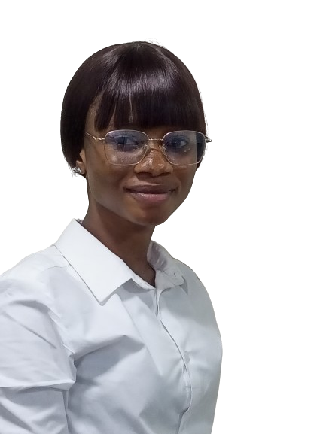
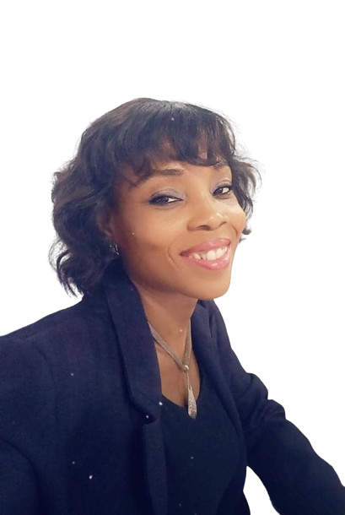
Staff CELEBRATIONS
OYELADE ENIOLA
13th
BELLO BABATUNDE PASCAL
17th
DIANA ONUKWUBE
19th
Join us as we celebrate our amazing team members.
May they enjoy blessings, celebration, and wonderful moments.
We wish you continued success and happiness in the year ahead.
A monthly publication of FSIB
Volume 2024 – June Edition

Slide 22
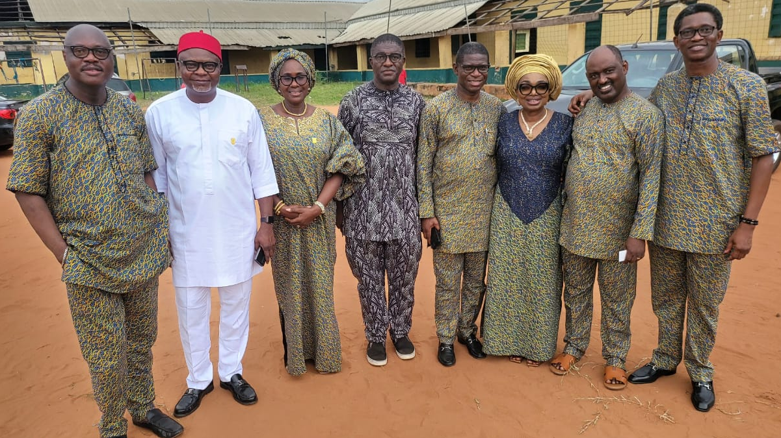
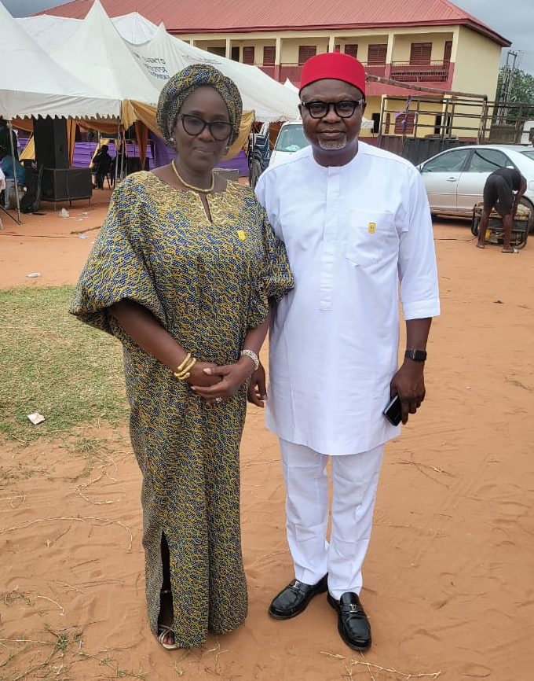
The MD/CEO of First Standard Insurance Brokers and the Company Secretary, Barr. Tony Ibekwe
The MD/CEO of FSIB with Members and Well Wishers of the Family at the Burial Ceremony of the Mother of the Company Secretary, Late Mrs. Nwachinemelu Lucy I. Ibekwe.
The MD/CEO of First Standard Insurance Brokers and Mazi Uche Unigwe
A monthly publication of FSIB
Volume 2024 – June Edition

Slide 23
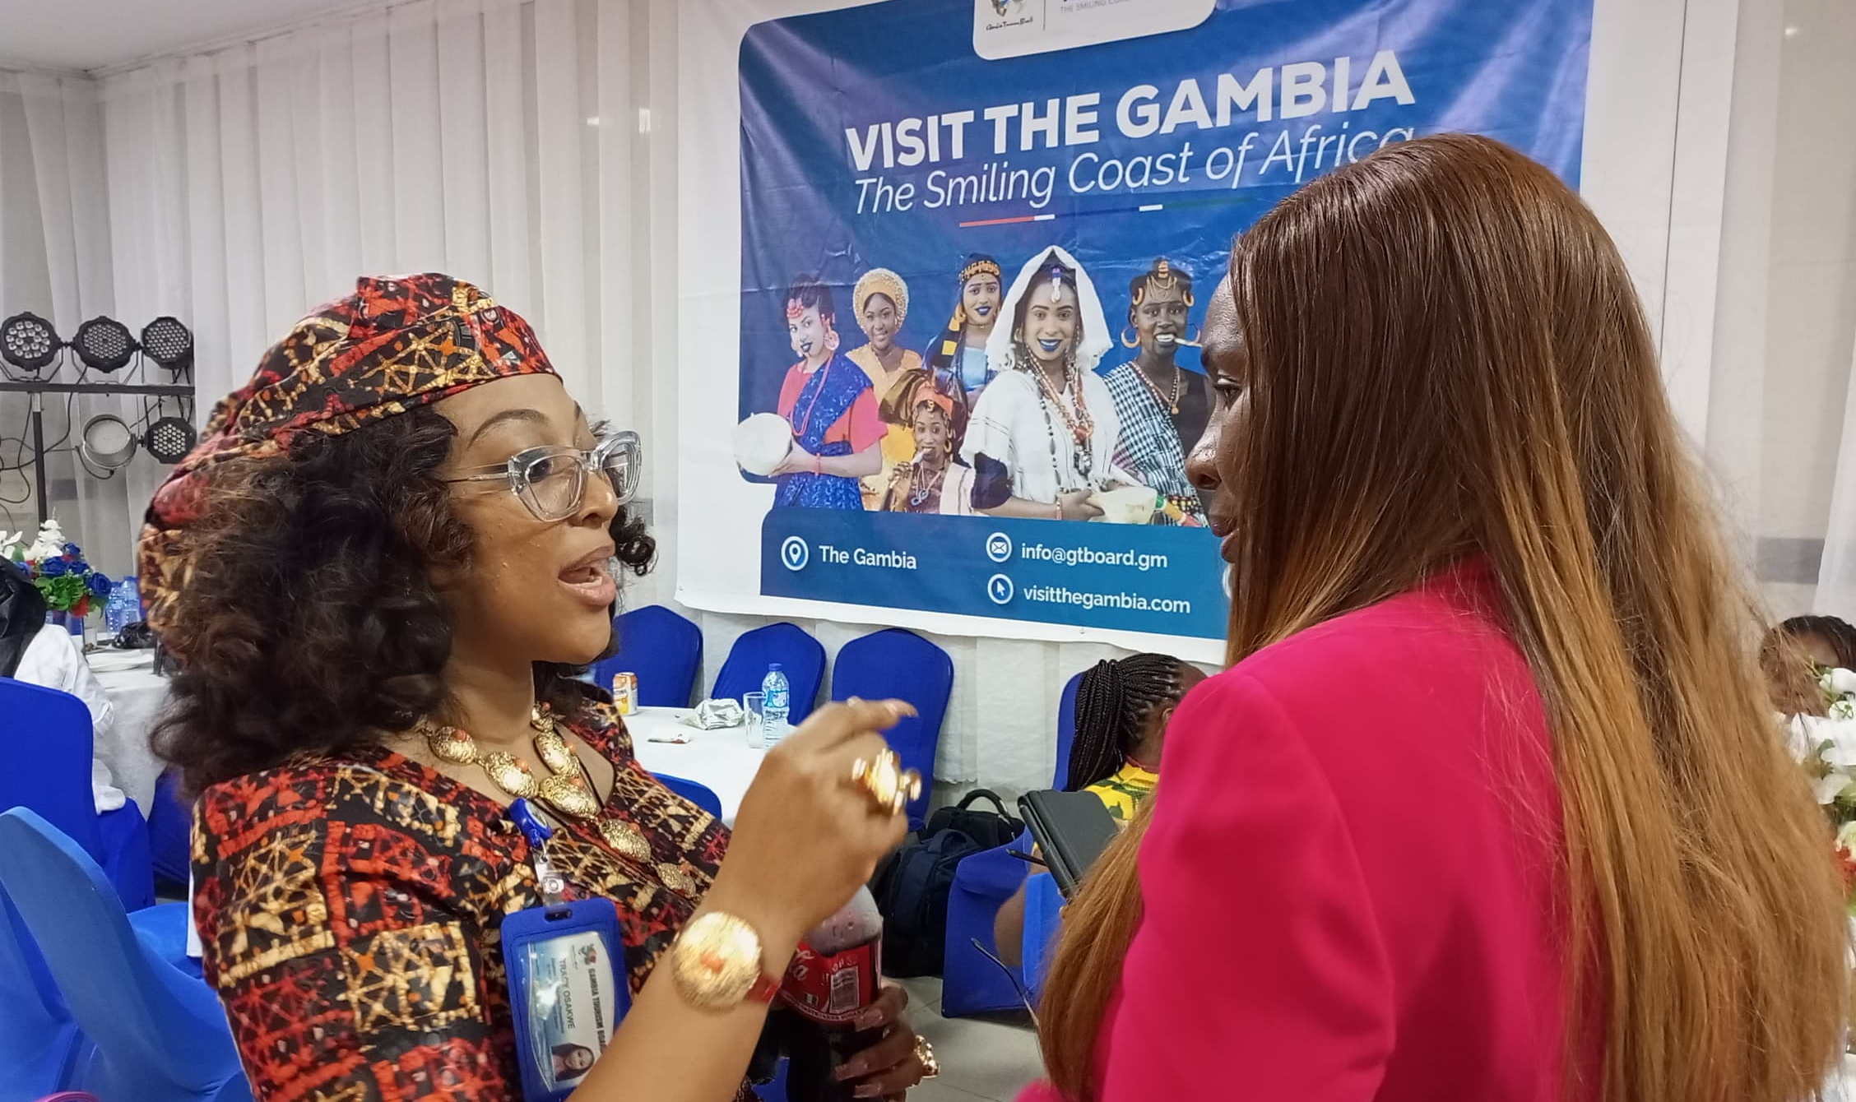
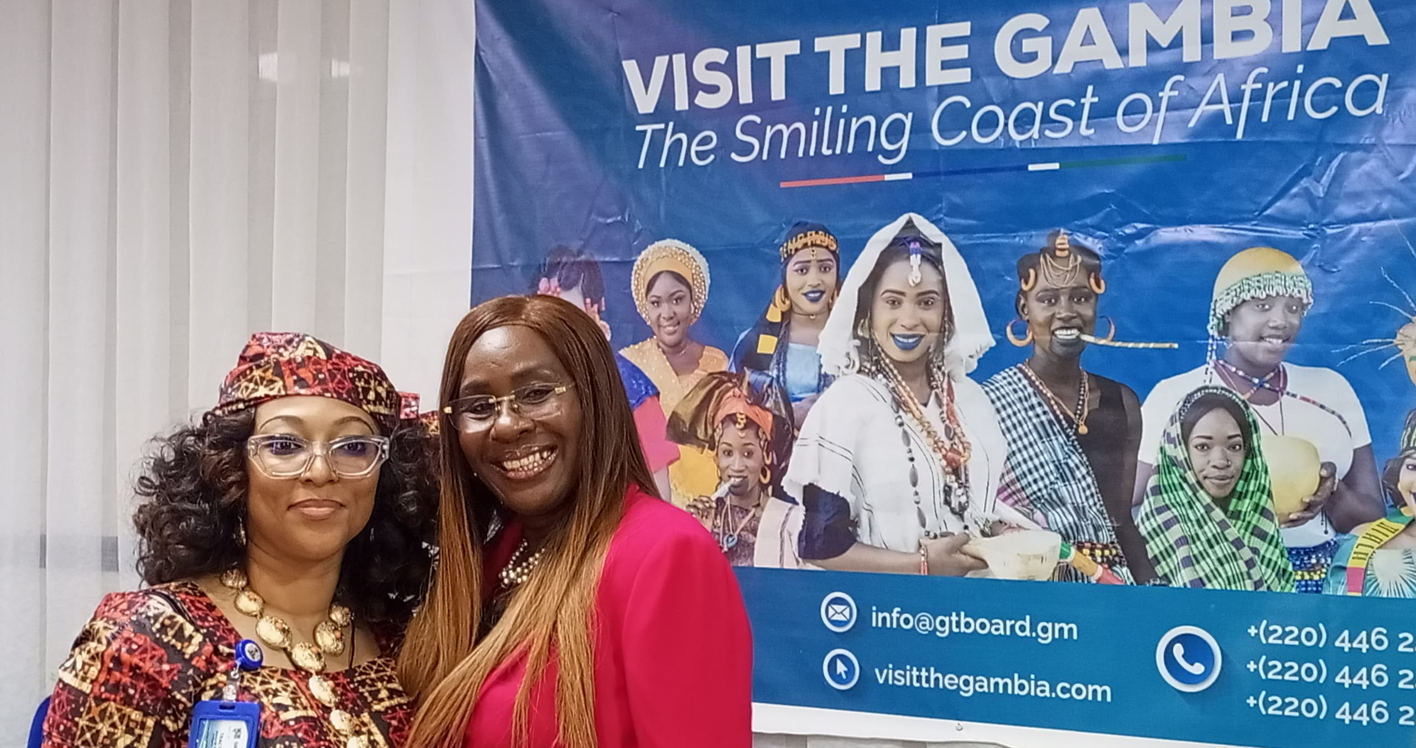
The MD/CEO of FSIB in a conversation with the Team Lead of the Organizing Committee of Gambia Tourism Board’s Economic, Trade and Investment Forum in Lagos on the 27th of May, 2024
The Executive Assistant to the MD/CEO of FSIB, Elvis Ejiofor actively engaging Mr. Musa Dem, the Package Development Manager, Gambia Tourism Board and other attendees at the event..
A monthly publication of FSIB
Volume 2024 – June Edition

Slide 24
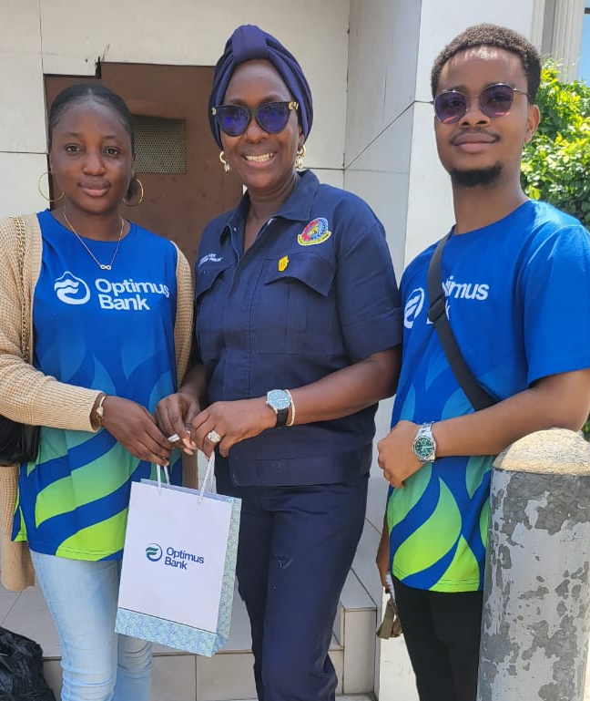
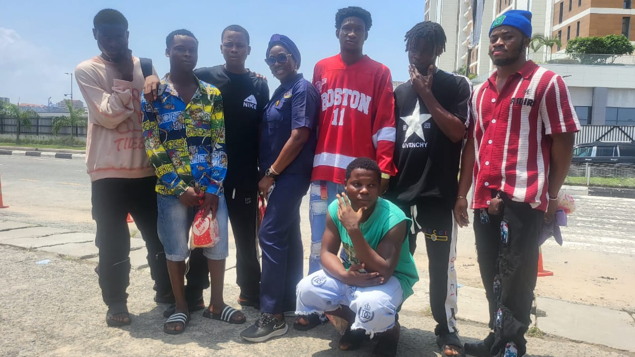
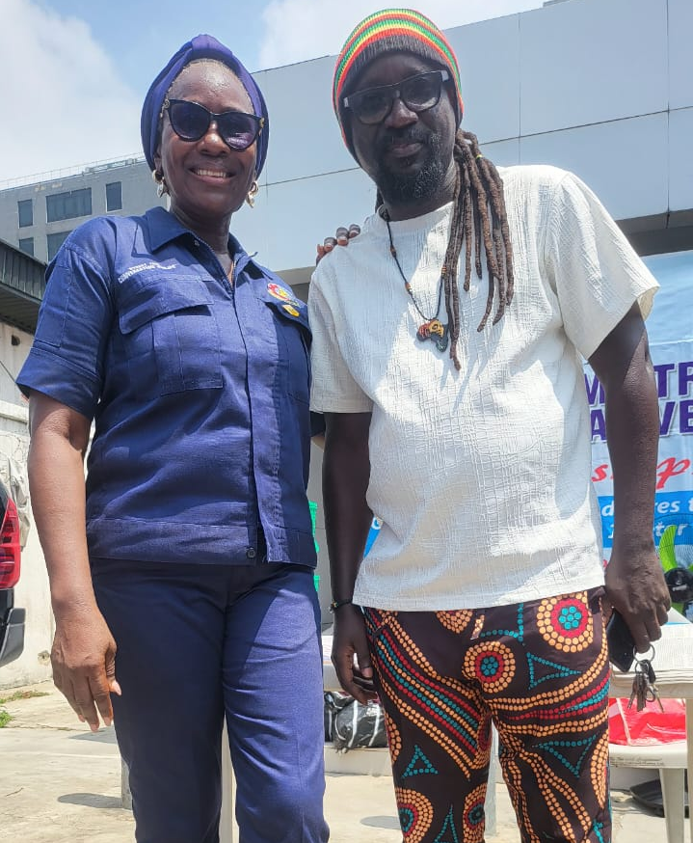
CSR ENGAGEMENTS
(CHANGE FROM STREET LIFE INITIATIVE)
The MD/CEO with Staff of the Optimus Bank During an Outreach
The MD/CEO of FSIB with Members of the Dance Legend Group During a Street Outreach
The MD/CEO of First Standard Insurance Brokers and Ratata of Wazobia, an Attendee of the Street Outreach
A monthly publication of FSIB
Volume 2024 – June Edition

Slide 25
APPRECIATION
On behalf of the Management and Staff of First Standard Insurance Brokers Limited,
We take this moment to express our heartfelt appreciation for your trust in our business.
Thank you for supporting FSIB.
A monthly publication of FSIB
Volume 2024 – June Edition

Slide 26
A monthly publication of FSIB
Volume 2024 – June Edition

